Slide 1
DeejAI T
Fei Xiao
Ji Lihong
Nuñez Andrey
Svobodova Eliska
Walzthony Eric

Slide 2
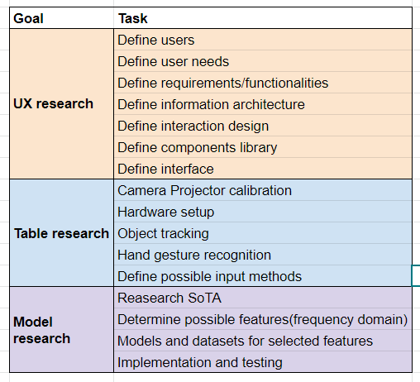
Task distribution

Slide 3
UX Research

Slide 4
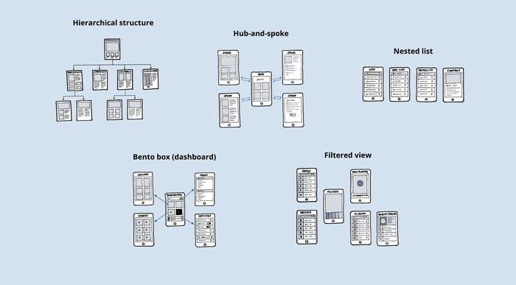
Information architecture

Slide 5
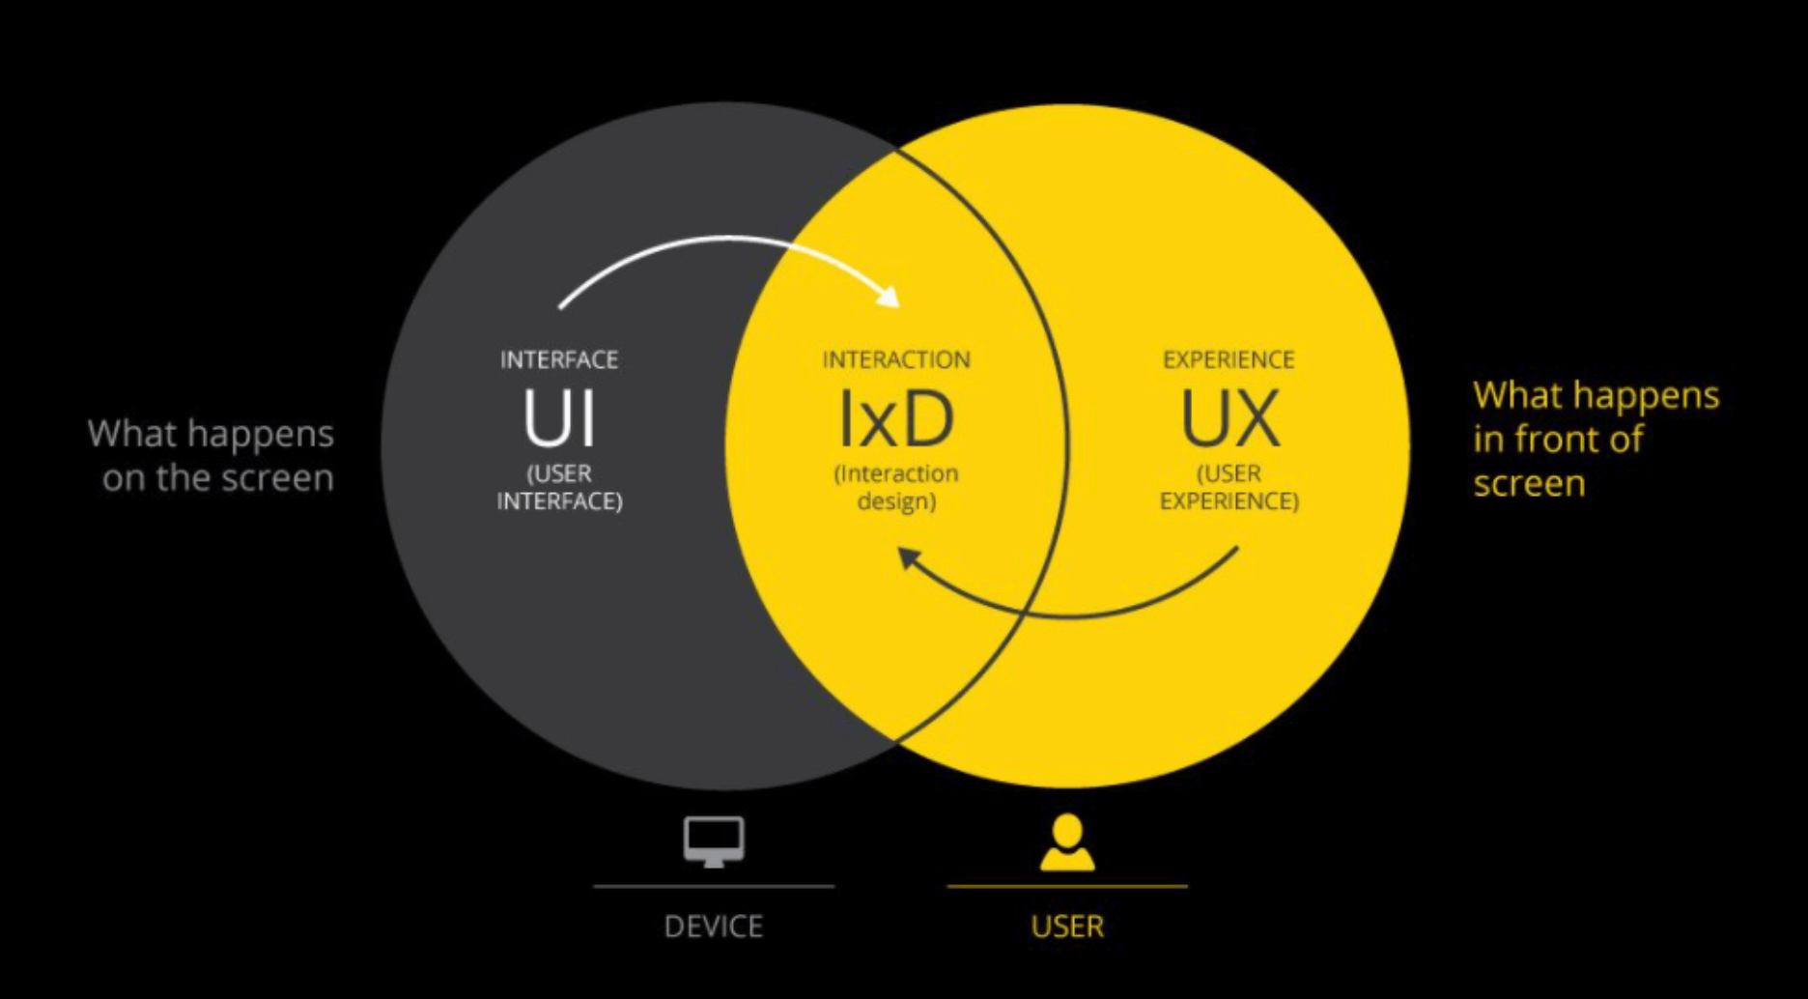

Slide 6
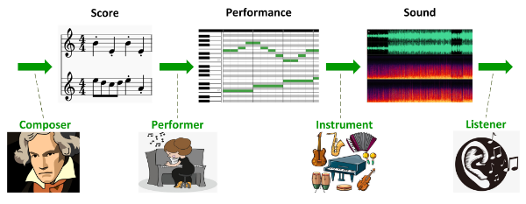
Music generation tasks
Score generation - melody, coordination of instruments (what tones should sound at the same time)
Monophonic (melody), Polyphonic (more independent melodies), Multi-track (multiple instruments)
Performance generation - tempo, timing, dynamics
Audio generation - pure acoustic information (waveform, spectrum)

Slide 7
Methods overview
Probability models (ex. Markov chains, Bayesian networks) - can only re-use sequences from train dataset
Rule-based models - often hand-made and style-specific
Evolutionary algorithms (ex. Genetic algorithm - GenJam) - difficult to define fitness functions and extract usable pieces of musical information
Neural networks:
RNN (LSTM), VAE, GAN, Transformer

Slide 8
Score generation
Melody generation:
RL-Tuner (2017) - sequential learning combining ML and RL, pre-trained RNN provides reward
Music VAE (2018) - polyphonic music, good music reconstruction abilities, hierarchical decoder
Polyphony
PianoTree VAE (2020) - tree structure of music syntax (reflects hierarchical nature of music), polyphonic
MuseNet (2019) - transformer, based on GPT-2, 4 min tracks, 10 instruments, various styles, decoder predicts next token at each time step
Multi-track music
MusAE (2020) - reconstructs phrases with high precision, change specific attributes of songs
Other tasks: given chord, compose melody; melody / track harmonization (accompany it)

Slide 9
Audio Generation, Score-to-Audio
Audio synthesis
WaveNet (2016) - CNN-based
DrumGAN (2020) - drum audio
Singing Voice Synthesis
DCGAN-based (2019) - takes frame-wise linguistic, frequency features, singer identity
FastSpeech-based (2020)
Score-to-Audio
LSTM with the help of WaveNet-based audio generator
PerformanceNet (2019) - mapping between symbolic repr. Of pianorolls and their audio repr., deep convolution model
Mel2Mel ( 2019) - polyphonic music, explainable embedding space

Slide 10
Other music generation tasks
Style transfer - genre, rhythm
Audio style transfer - voice, instruments, intonations
Singing style transfer - conversion to another singing voice, speech-to-sing
Interactive generation
Call and response - human plays on a keyboard, AI generates a song that is nearest to it in the embedding space (generates similar melody)
Accompaniment
Music completion
Generation of music based on given emotion

Slide 11
Brief structure of GAN
Input
(transformed into vectors)
generator
Real examples
Generated examples
discriminator
Update model
Update model
Binary classification

Slide 12
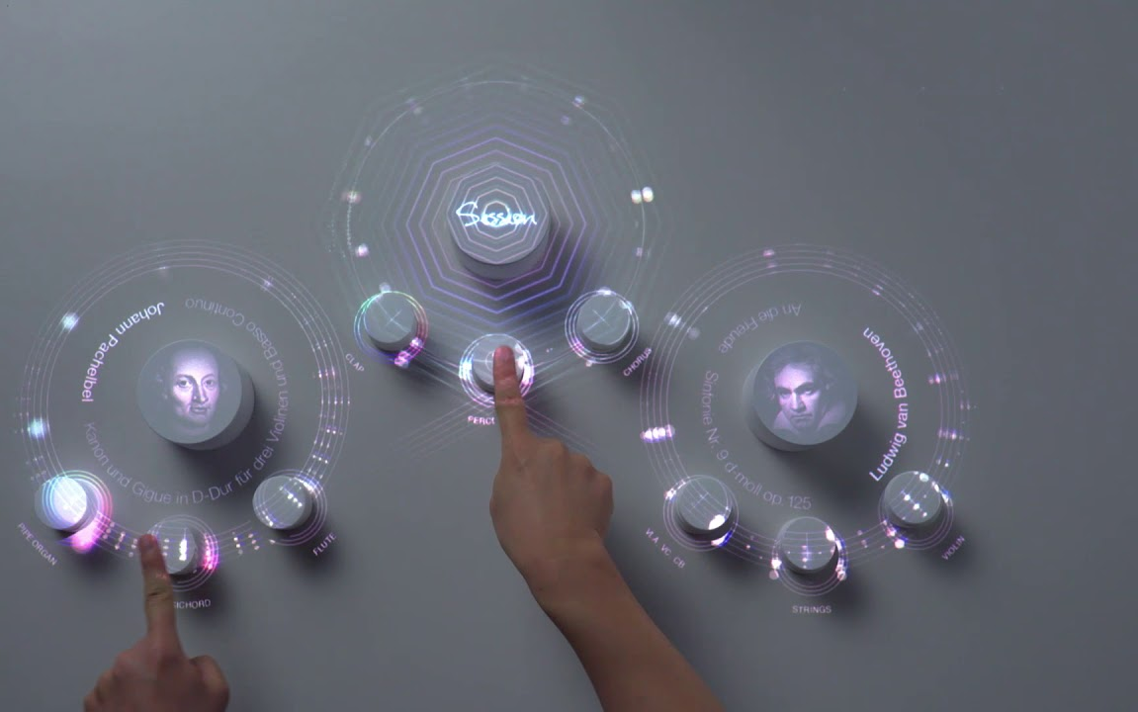
Interactive table tasks
To design and implement a novel approach to generate music with the interactive table.

Slide 13
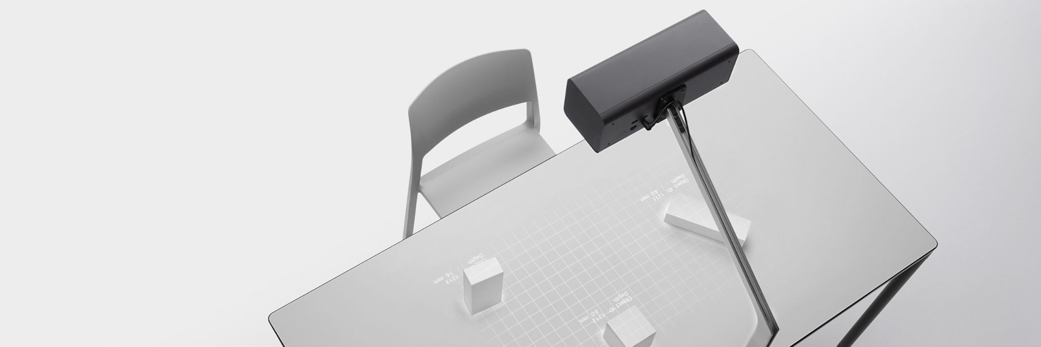
Interactive table system
Hardware structure
Camera
Tracking
Projector
Display Surface
Object/ Token/
Touch screens
https://first-flight.sony.com/pj/t

Slide 14
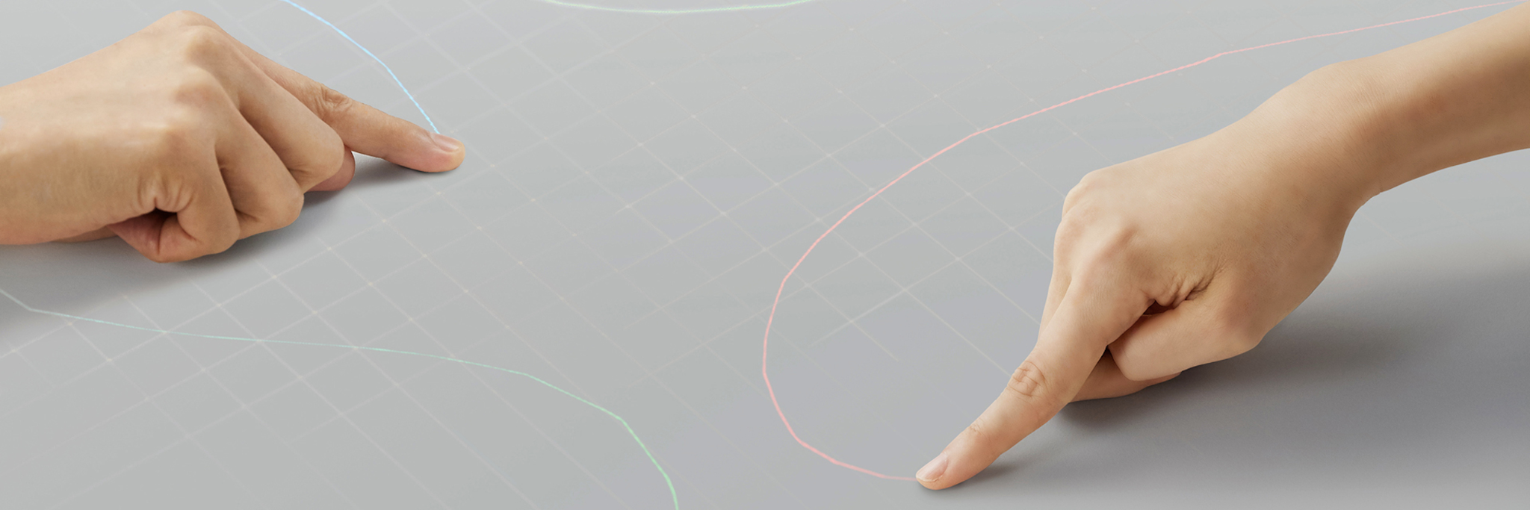
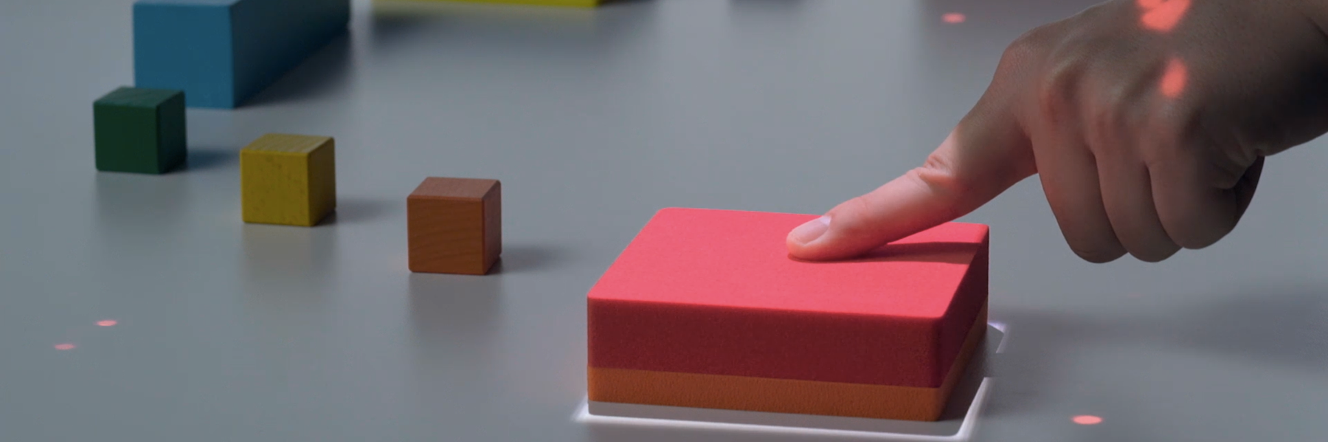
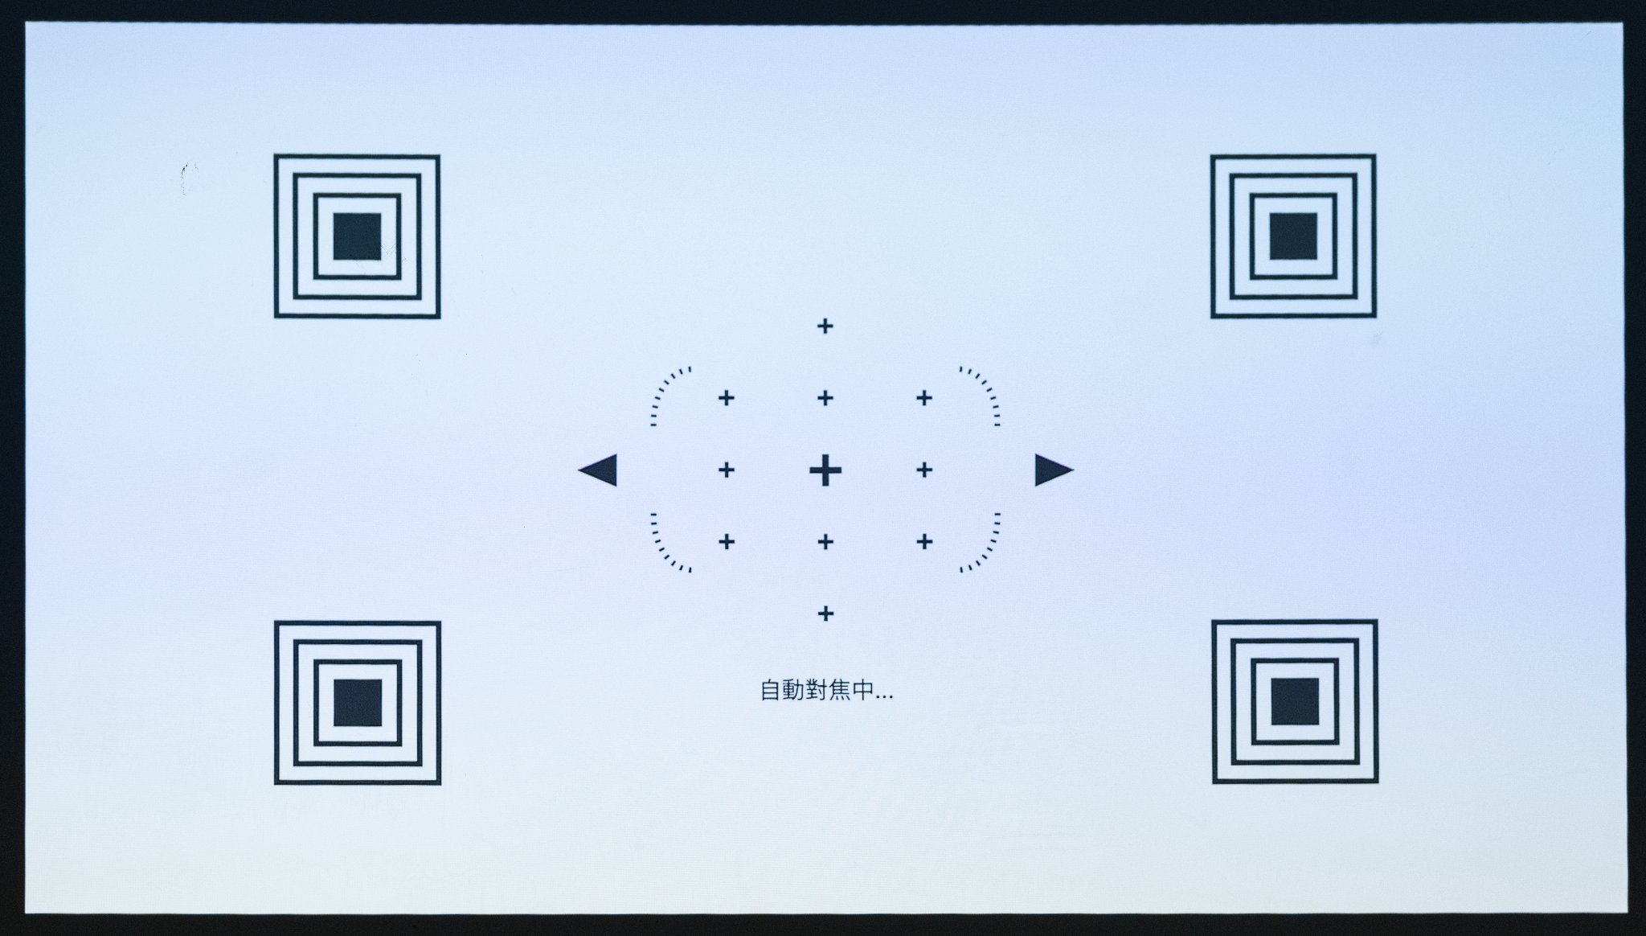
Interactive table system
Software structure
Music Generation Framework
Calibration
Inputs
Clicking Detection
Cam-Proj Calibration Image
Fingering tracking
Camera Input
Object / Gesture Detection
UI
Outputs
Display
Projection
Render

Slide 15
Interactive table system
Objective and Tasks

Slide 16
Challenges
Synchronize our model, table interface and input/output systems
Define ideal models for melody generation, lyrics generation and image generation
Test different architectures on the table setup
Design an effective and reliable way to recognise user inputs
Identify users that match our scope to survey and get feedback as needed

